Slide 1
Wall following robot
By: Vivek Ponnala

Slide 2
Index
Project introduction
Literature survey
Theoretical analysis
Experimental Investigations
Flowchart
Result
Advantages/Disadvantages
Applications
Conclusion
Future Scope
Bibliography
Appendix
Thank you

Slide 3
Project introduction
Building a robot applications which identifies the wall/obstacles and follows the wall for a certain distance.
Wall following robots are widely used in industry applications.

Slide 4
Literature survey
Problem: Robots are not able to navigate through obstacles in their path
Solution: Build robot application to help robots navigate and create mapping environment

Slide 5
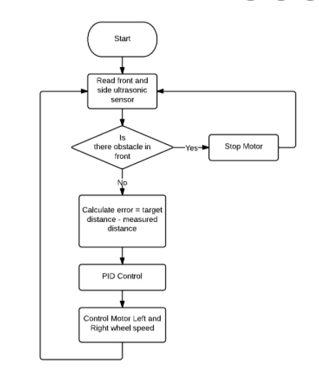
Theoretical Analysis

Slide 6
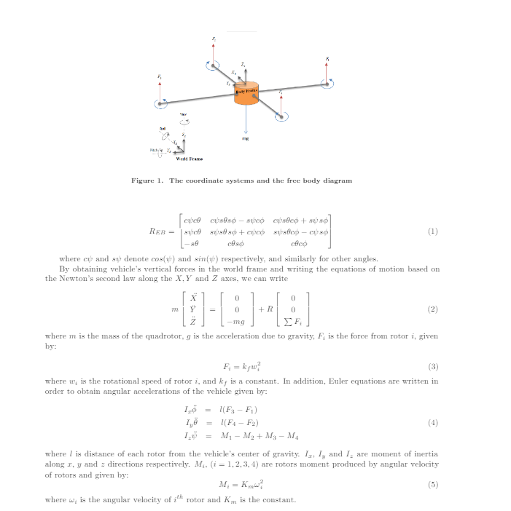
Experimental Investigations

Slide 7
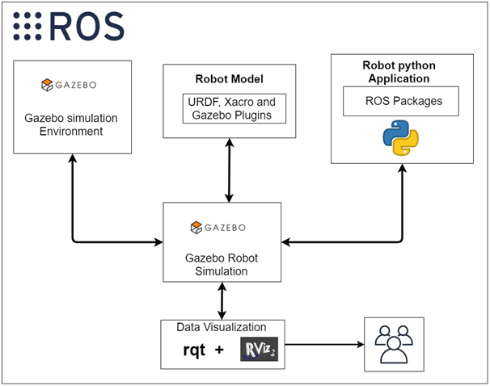
Flowchart

Slide 8
Result
Robot moves along specified path next to wall in Rviz and Gazebo
Robot camera effectively captures robot's movements
Robot laser effectively detects robot's surroundings

Slide 9
Advantages/Disadvantages
Advantages:
1) It's relatively cheap.
2) They can also be used for long distance.
Disadvantages:
1)Laser may be unable to detect surroundings.
2)Requires the presence of a wall

Slide 10
Applications
1) They can be used in industries as automated equipment carriers..
2) It can be used for home for floor cleaning etc.

Slide 11
Conclusion
Hence, wall following robots are useful.

Slide 12
Future scope
Artificial intelligence for predicting and detecting crime
Evolution of cloud connected robots

Slide 13
Bibliography
https://smartinternz.com/Student/guided_project_workspace/4827
https://www.allerin.com/blog/are-you-aware-of-these-7-challenges-in-robotics
https://www.researchgate.net/publication/280880975_Autonomous_Wall-Following_Ba
sed_Navigation_of_Unmanned_Aerial_Vehicles_in_Indoor_Environments
https://www.futurelearn.com/info/courses/begin-robotics/0/steps/2845
https://brainly.in/question/1620369
https://blog.robotiq.com/10-ways-robotics-could-transform-our-future

Slide 14
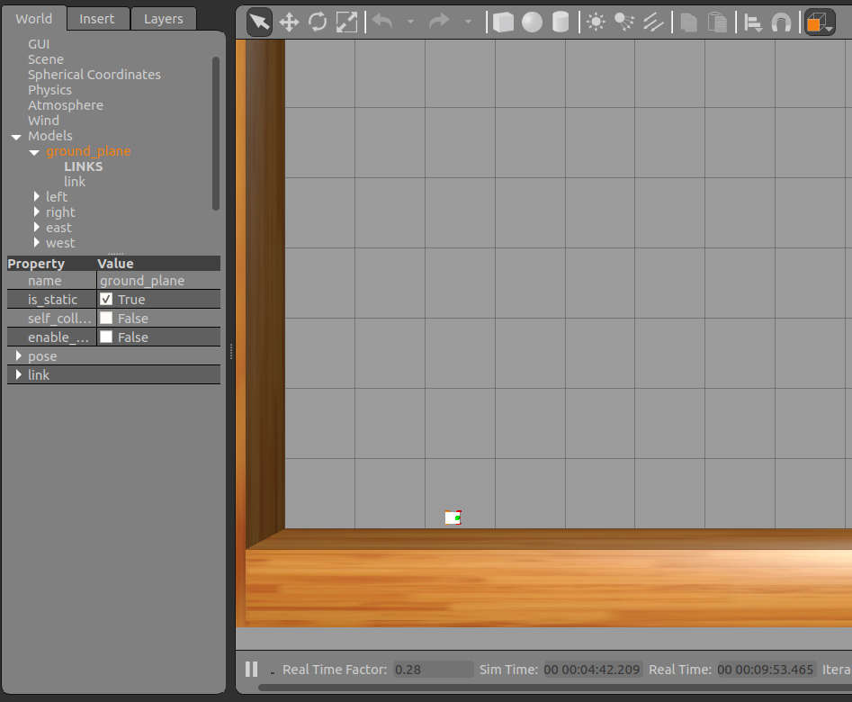
Appendix

Slide 15

Thank you

